Slide 1
Brush up your English!

Slide 2
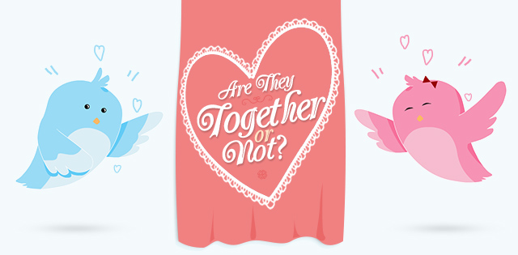
Are they together or not?

Slide 3
Everyday vs Every day
If you want it to mean something you do daily, use ‘every day’.
E.g. Melissa eats chicken rice every day.
‘Everyday’ means something ordinary or typical.
E.g. Packed trains are an everyday occurrence.

Slide 4
Alot vs A lot
This one is simple. There’s no such word as alot.
So just use ‘a lot’.

Slide 5
Maybe vs May be
‘Maybe’ and ‘may be’ are used in different parts of a sentence.
‘Maybe’ is an adverb that has the same meaning as perhaps.
Maybe size M will be a better fit.

Slide 6
Maybe vs May be
‘May be’ is a verb phrase indicating possibility.
E.g. Darren may be going to France.
When you are unsure of which version to use, try this tip: Replace the word with perhaps.
If ‘perhaps’ fits, use ‘maybe’. Or else, use ‘may be’.

Slide 7
Anyway vs Any way
‘Anyway’ means regardless or in any event. E.g. It doesn’t matter if you’re not going for lunch, I’m
still going anyway.
‘Any way’ means any particular course, manner or direction. E.g. The chef will prepare the chicken in any way the customer likes it.

Slide 8
Plural Verbs
Nouns which have two parts such as spectacles, scissors and pants require plural verbs.
E.g. Those pants are too loose. ✔
Those pants is too loose. ×

Slide 9
Than vs Then
‘Than’ is used when comparing things.
E.g. Women generally have a longer life span than men.
For all other instances, use ‘then’.

Slide 10
A vs An
Focus on the sound at the start of the following word. If the following word starts with a consonant sound, then use ‘a’.
e.g. a ball, a girl, a university, a watch
If the following word starts with a vowel sound, then use ‘an’.
e.g. an apple, an hour, an extremely fun day,
an unpleasant smell

Slide 11
